Slide 1
Accelerating Systems with Programmable Logic Components Lecture 06 Synthesis I Writing Synthesizable Verilog
1DT109 ASPLOC
2022 VT1-VT2
Yuan Yao, yuan.yao@it.uu.se

Slide 2
Agenda
What is synthesis
Writing synthesizable Verilog

Slide 3
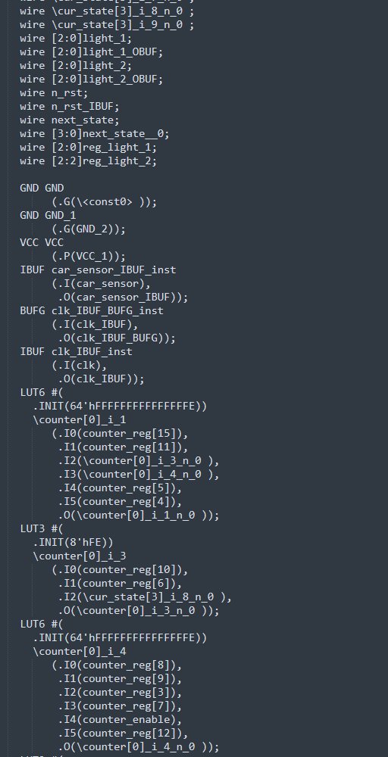
What is synthesis?
Example netlist frag of the FSM project
Synthesis is the process of constructing a gate-level netlist from a register-transfer level (RTL) model of a circuit described in Verilog HDL.
A netlist is a description of the connectivity of an electronic circuit.
This is the definition of synthesis used in Lecture 6 Synthesis I and Lecture 7 Synthesis II.
Other ways of synthesis exist such as high-level synthesis
From C-style code to netlist

Slide 4


The synthesis process
Front-end
design process
Verilog HDL model
Synthesis
Un-optimized netlist
Logic optimizer
Optimized netlist
RTL module builder
A design may relay on predefined RTL blocks. In such case, an RTL module builder is needed.
The RTL model builder acquires a predefined RTL model from a technology library.
Target technology
The RTL builder may also need the constraints to select proper components.
Area/timing
constraints
How small should a design be?
How fast should a design run?

Slide 5
Check the design methodology, regularly.
HDL & Graphic entry
Debug
Front-end
design process
Functional verification
Cultivate a good taste of your code, for synthesis.
Synthesis
Map & Place & Routing
Debug
Back-end
design process
Timing verification
Debug
Program & System test

Slide 6
Writing synthesizable Verilog
Elements
Logic value
Variable
Constant
Parameter
Basic building blocks
Continuous assignment
Procedural assignment
Logic operator
Arithmetic operator
Relational operator
Equality operator
Shift operator
Vector operator
Always statement
If statement
Case statement
Loop statement

Slide 7
Example synthesizable designs
Example designs
Counter
Binary counter
Modulo-N counter
Johnson counter
Gray counter
A pattern detector
A factorial generator

Slide 8
Synthesis optimization techniques
Resource allocation
Common subexpression
Code revising
Code restructure
Using parentheses
Avoiding Flip-flops
Avoiding latches

Slide 9
Elements – Logic value
The common values used in modeling hardware are
Logic-0
Logic-1
High-impedance
Don’t-care
Unknown
Verilog | Synthesis
0 | Logic-0
1 | Logic-1
z | High-impedance
z | Don’t-care (in casex and casez)
x | Don’t-care (in casex)
x | Unknown

Slide 10
Elements – Variable (net)
In Verilog, a variable belongs to one of the two data types:
Net data type
value does not hold
Register data type
value holds
There are other net types. We will only focus on wire and tri in 1DT109 ASPLOC
wire, wor, wand, tri, supply0, supply1
The size of a net is explicitly specified in a net declaration
wire [4:0] Data // A 5-bit wire net.
When no size is given, the default size is 1-bit

Slide 11
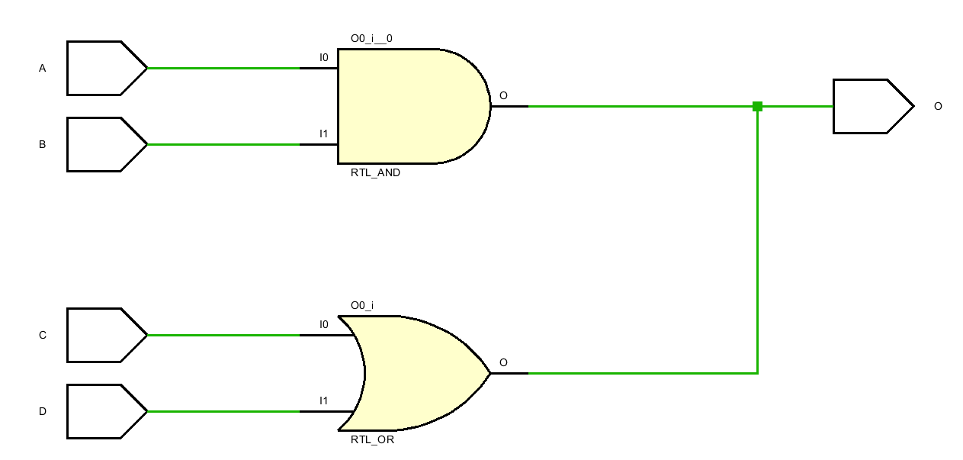
Element – Variable (net)
The wire net is the most used net type.
When there are multiple drivers driving a wire, the outputs of the drivers are shorted together.
Don’t do this in practice.
module demo_1 (A, B, C, D, O);
input A, B, C, D;
output O;
wire O;
assign O = A & B;
assign O = C | D;
endmodule // demo_1

Slide 12
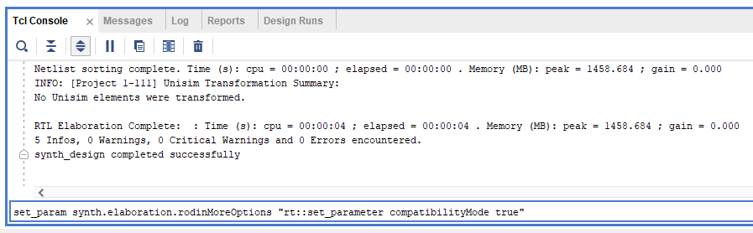
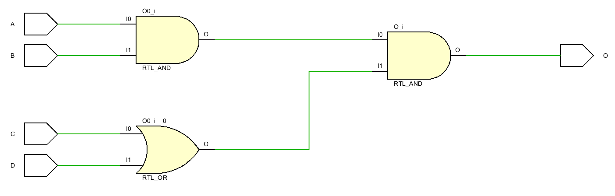
Element – Variable (net)
Type this command in the TCL console and press “enter” to enable Vivado to synthesis wor/wand
The wor and wand nets are used when multiple driver resolution needs to be performed using or-logic and and-logic respectively.
On synthesis, multiple drivers of such a net are connected by or gate (for wor net) and and gate (for wand net).
module demo_2 (A, B, C, D, O);
input A, B, C, D;
output O;
wand O;
assign O = A & B;
assign O = C | D;
endmodule // demo_2

Slide 13
Element – Synthesize of a net variable
The wire variable O is synthesized using hardware wire.
It cannot hold a value but only be driven by upstream circuit.
Wire is by nature the best way to model connecting wire/bus
module demo_2 (A, B, C, D, O);
input A, B, C, D;
output O;
wand O;
assign O = A & B;
assign O = C | D;
endmodule // demo_2

Slide 14
Element – Variable (register)
There are two register types that are supported for synthesis
reg
integer
A reg declaration explicitly specifies the size. Otherwise, default size is 1-bit.
reg [0:31] data; // 32-bit reg
reg ctrl; // 1-bit reg
The default width for integer is 32 bits and the number is assumed to be in 2’s complement form.
Cannot explicitly define bit width for integer. integer [7:0] sum;
Do not accept the unsigned keyword. unsigned integer sum;
Unlike wire, don’t drive reg from multiple always blocks!

Slide 15
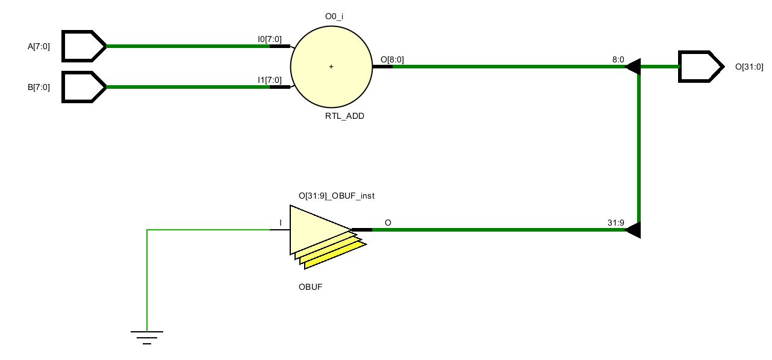
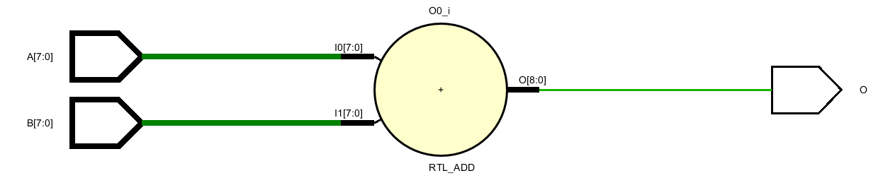
Element – Variable (register)
Must an integer always 32-bit exactly?
The synthesizer can optimize width for reg (and wire)
module demo_3 (A, B, O);
input [7:0] A, B;
output [31:0] O;
integer sum;
assign O = sum;
always @ (A, B)
sum = A + B;
endmodule //demo_3
module demo_4 (A, B, O);
input [7:0] A, B;
output O;
integer sum;
assign O = sum;
always @ (A, B)
sum = A + B;
endmodule //demo_4
Declare the integer and leaves the rest to the synthesizer.

Slide 16
Element – Synthesize a register variable
module demo_4 (A, B, O);
input [7:0] A, B;
output O;
integer sum;
assign O = sum;
always @ (A, B)
sum = A + B;
endmodule //demo_4
In Verilog, a register variable retains its value through the entire simulation run thus implies a memory element (latch or flip-flop).
In this example, by default, integer sum implies a memory element.
However, since its value is updated whenever A or B change, thus the synthesizer optimized the memory element out.
What if
always @ (A, B)
sum <= A + B;

Slide 17
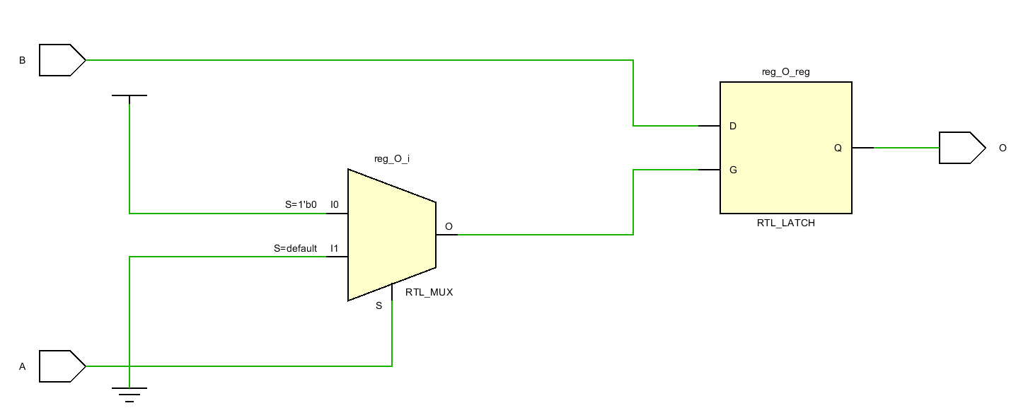
Element – Synthesize a register variable
In this example, the always is triggered by inputs A and B.
When A is 0, the assignment occurs. The circuit behaviors as a combi-logic.
However, when A is 1, the circuit needs to retains the value of reg reg_O.
In summary:
A == 0, reg_O = B;
A == 1, reg_O keeps
Level sensitive latch
module demo_5 (A, B, O);
input A, B;
output O;
reg reg_O;
assign O = reg_O;
always @ (A, B) begin
if (!A)
reg_O = B;
end
endmodule

Slide 18
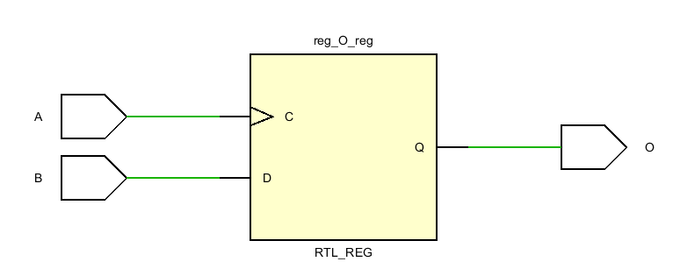
Element – Synthesize a register variable
module demo_6 (A, B, O);
input A, B;
output O;
reg reg_O;
assign O = reg_O;
always @ (posedge A) begin
reg_O <= B;
end
endmodule

Slide 19





Element – Constant
There are three kinds of constants in Verilog
integer
real
string
Real and string constants are not supported for synthesis.
Example of integer as constants (demo_7)
integer a = 30; // signed number, 5-bit
integer a = -2; // signed number, 32-bit in 2’s complement
integer a = 2’b10; // size of 2 bits
integer a = -6’b10; // signed number, 32-bit in 2’s complement
integer a = -‘sd10; // signed number, 32-bit in 2’s complement
Always check the RTL analysis to see what constant you have decleared
Note that unlike in C/C++, you can over-write all the constants in Verilog.
Be careful.

Slide 20




Element – Parameter
Parameter is a named constant.
No size is allowed to be specified for a parameter.
The size of the parameter is the same as the size of the constant itself.
Example of parameter (demo_8)
parameter A = 30;
parameter A = -2;
parameter A = 2’b10;
parameter A = -6’b10;
parameter A = -’sd10;
You cannot over-write a parameter.
Don’t bother remembering how data types are synthesized.
Check the RTL analysis regularly.
Mind the difference with integer a=-6’b10
integer a = -6’b10; // signed number, 32-bit in 2’s complement

Slide 21
Basic building blocks
Continuous assignment
Procedural assignment
Logic operator
Arithmetic operator
Relational operator
Equality operator
Shift operator
Vector operator
Always statement
If statement
Case statement
Loop statement

Slide 22
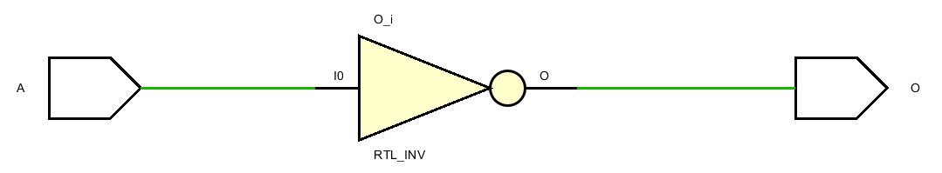
Continuous assignment
A continuous assignment (assign) represents, in hardware, logic that drives left-hand net with right-hand expression.
A continuous assignment is always synthesized into net driven by combinational logic.
All kinds of # delay in assign are ignored.
module demo_9 (A, O);
input A;
output O;
assign #1 O = ~A;
endmodule

Slide 23
Procedural assignment
Blocking assignment
A blocking assignment (=) represents, in hardware, logic that drives left-hand variable with right-hand expression.
Blocking assignment mirrors the dataflow in a combinational circuit.
Non-blocking assignment
A non-blocking assignment (<=) represents, in hardware, logic that drives left-hand variable with right-hand expression.
Non-blocking assignment mirrors the dataflow in a sequential circuit.
All kinds of # delay are ignored

Slide 24
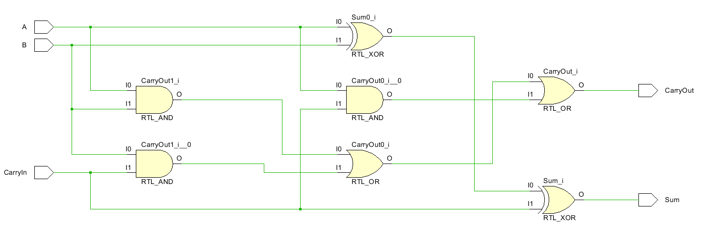
Logic operator
The logic operators get directly mapped onto primitive logic gates in hardware.
In ASIC, the library files define all the implementation details of logic gates.
In FPGA, everything is reduced to LUT.
module demo_10_full_adder (A, B, CarryIn, Sum, CarryOut);
input A, B, CarryIn;
output Sum, CarryOut;
assign Sum = (A ^ B) ^ CarryIn;
assign CarryOut = (A & B) | (B & CarryIn) | (A & CarryIn);
endmodule

Slide 25
Arithmetic operator
In Verilog, a net/reg type represents an unsigned number.
Use net/reg for synthesizing unsigned arithmetic logic
An integer or reg signed type represents a signed number in 2’s complement.
Use integer or reg signed for synthesizing signed arithmetic logic
Don’t mix signed and unsigned operands up
Verilog will use unsigned arithmetic logic if one of the operands is unsigned
This is very important but being ignored 99% of the time.
C = A × B
signed/unsigned
8’hff
signed/unsigned
8’f0
signed/unsigned

Slide 26
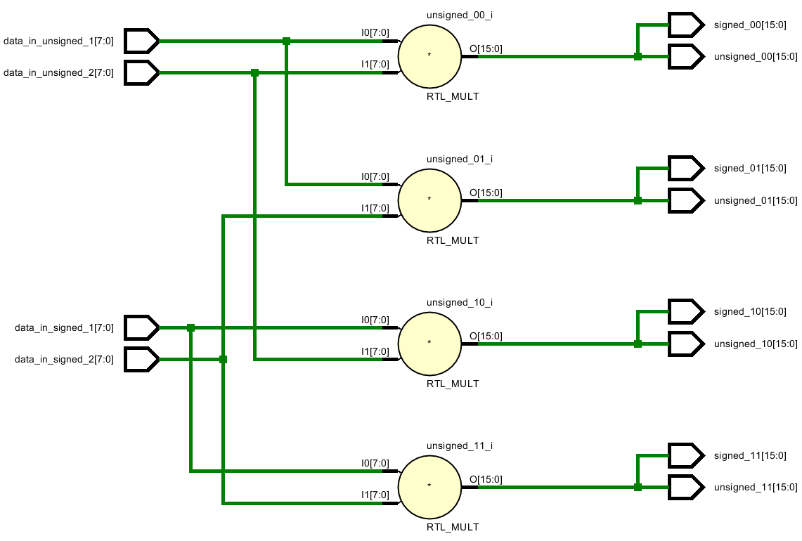
Arithmetic operator – Mind your sign
module demo_11_signed_multiplier(
input [7:0] data_in_unsigned_1, //8’hff
input [7:0] data_in_unsigned_2, //8’hf0
input signed [7:0] data_in_signed_1, //8’hff
input signed [7:0] data_in_signed_2, //8’hf0
output [15:0] unsigned_00,
output [15:0] unsigned_01,
output [15:0] unsigned_10,
output [15:0] unsigned_11,
output signed [15:0] signed_00,
output signed [15:0] signed_01,
output signed [15:0] signed_10,
output signed [15:0] signed_11
);
assign unsigned_00 = data_in_unsigned_1 * data_in_unsigned_2;
assign unsigned_01 = data_in_unsigned_1 * data_in_signed_2;
assign unsigned_10 = data_in_signed_1 * data_in_unsigned_2;
assign unsigned_11 = data_in_signed_1 * data_in_signed_2;
assign signed_00 = data_in_unsigned_1 * data_in_unsigned_2;
assign signed_01 = data_in_unsigned_1 * data_in_signed_2;
assign signed_10 = data_in_signed_1 * data_in_unsigned_2;
assign signed_11 = data_in_signed_1 * data_in_signed_2;
endmodule //demo_11
initial begin
data_in_unsigned_1 = 8'hff; //255
data_in_unsigned_2 = 8'hf0; //240
data_in_signed_1 = 8'hff; //-1
data_in_signed_2 = 8'hf0; //-16
Signed/unsigned
does not affect output assignment.
Are they the same?

Slide 27
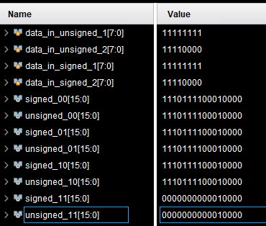












Arithmetic operator – Mind your sign
Verilog will use unsigned arithmetic logic if one of the operands is unsigned
Unsigned Logic
Rules of thumb No.10:
Don’t blend signed and unsigned numbers.
If you want, use $signed and $unsigned system functions.
Signed Logic
False positive

Slide 28
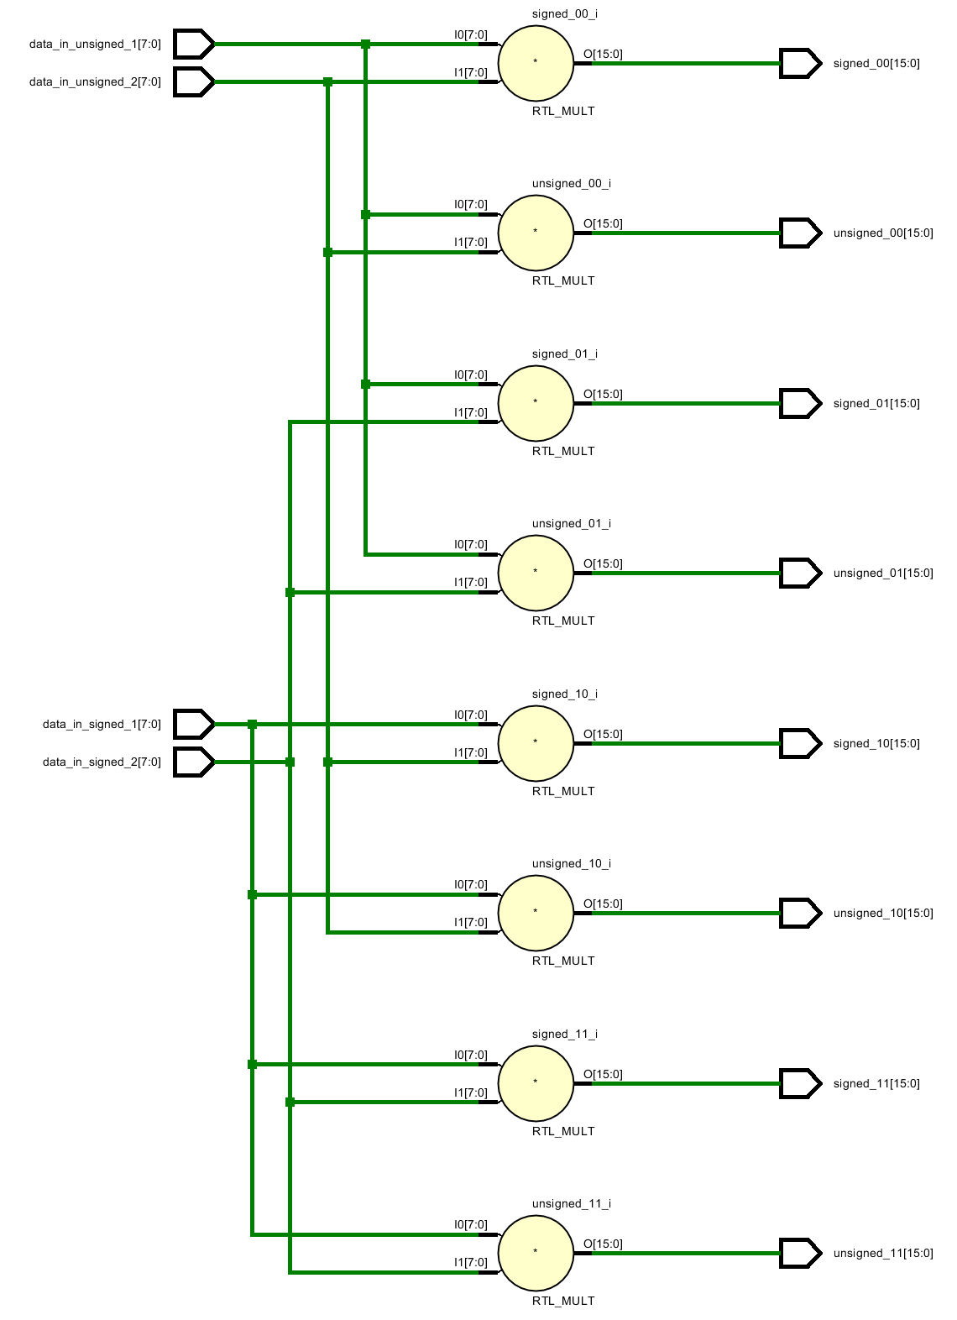





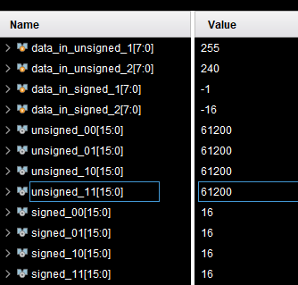

Arithmetic operator – Mind your sign
module demo_12_signed_multiplier(
input [7:0] data_in_unsigned_1, //8'hff
input [7:0] data_in_unsigned_2, //8'hf0
input signed [7:0] data_in_signed_1, //8'hff
input signed [7:0] data_in_signed_2, //8'hf0
output [15:0] unsigned_00,
output [15:0] unsigned_01,
output [15:0] unsigned_10,
output [15:0] unsigned_11,
output signed [15:0] signed_00,
output signed [15:0] signed_01,
output signed [15:0] signed_10,
output signed [15:0] signed_11
);
assign unsigned_00 = data_in_unsigned_1 * data_in_unsigned_2;
assign unsigned_01 = data_in_unsigned_1 * $unsigned(data_in_signed_2);
assign unsigned_10 = $unsigned(data_in_signed_1) * data_in_unsigned_2;
assign unsigned_11 = $unsigned(data_in_signed_1) * $unsigned(data_in_signed_2);
assign signed_00 = $signed(data_in_unsigned_1) * $signed(data_in_unsigned_2);
assign signed_01 = $signed(data_in_unsigned_1) * data_in_signed_2;
assign signed_10 = data_in_signed_1 * $signed(data_in_unsigned_2);
assign signed_11 = data_in_signed_1 * data_in_signed_2;
endmodule //demo_12
Use $signed and $unsigned to help the synthesizer to select the correct logic

Slide 29
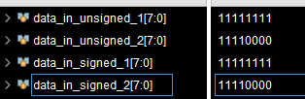

Arithmetic operator – Input interpretation
Directly from binary
begin
data_in_unsigned_1 = 8'hff; //255
data_in_unsigned_2 = 8'hf0; //240
data_in_signed_1 = 8'hff; //-1
data_in_signed_2 = 8'hf0; //-16
Directly from binary
data_in_unsigned_1 = 8'd128; //128
data_in_unsigned_2 = 8'd15; //15
data_in_signed_1 = -8'sd128; //-128
data_in_signed_2 = -8'sd15; //-15
Must use ’sd for signed decimal
In 2’s complement

Slide 30
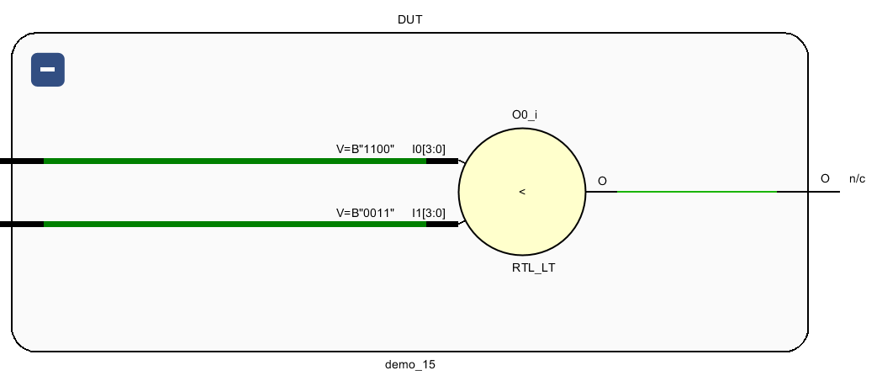
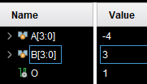
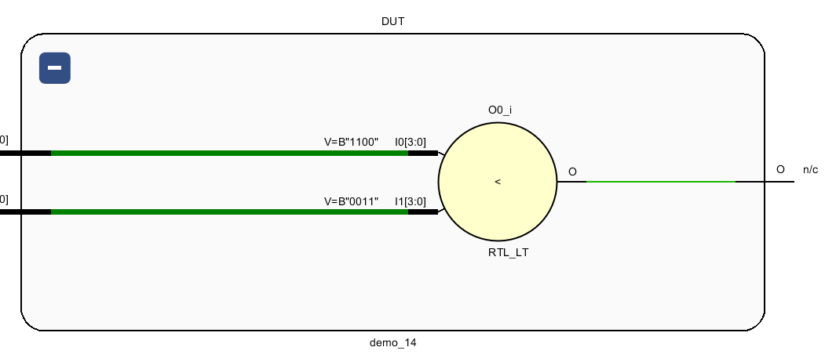

Relational operator
The relational operators supported for synthesis are:
>, <, >=, <=
Relational operators are modeled like arithmetic operators.
Different logic is synthesized depending on signed/unsigned operands.
net or reg: unsigned relational operator
signed reg or integer: signed relational operator
module demo_14(A, B, O);
input signed [3:0] A, B;
output O; reg signed O;
always @ (A, B)
O = $signed(A) < $signed(B);
endmodule //demo_15
reg [3:0] signed A, B;
wire signed O;
initial begin
A = 4'b1100;
B = 4'b0011;
module demo_13 (A, B, O);
input [3:0] A, B;
output O; reg O;
always @ (A, B)
O = A < B;
endmodule //demo_14
reg [3:0] A, B;
wire O;
initial begin
A = 4'b1100;
B = 4'b0011;

Slide 31
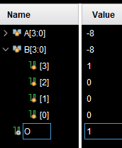
Equality operators
The equality operators supported for synthesis are:
==, !=
The case equality operators (===, !==) are not supported for synthesis
Equality operators are modeled like arithmetic operators in terms of whether signed or unsigned
Don’t compare signed with unsigned.
module demo_15 (A, B, O);
input signed [3:0] A, B;
output O;
reg signed O;
always @ (A, B)
O = $signed(A) == $signed(B);
endmodule
initial begin
A = 4'b1000;
B = -4'sd8;

Slide 32
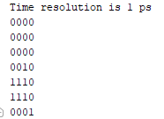
Shift operators
Verilog synthesis supports the left shift (<<, <<<) and the right shift (>>, >>>) operators.
<<, >>, logical shift, fill with zero
<<<, >>>, arithmetic shift, sign kept.
module demo_16 ();
reg [3:0] shift1 = 4'b1000;
reg signed [3:0] shift2 = 4'b1000;
reg signed [3:0] shift3 = 4’b0100;
initial begin
// Left Shift
$display("%b", shift1 << 1);
$display("%b", $signed(shift1) <<< 1); // Cast as signed
$display("%b", shift2 <<< 1); // Declared as signed type
// Right Shift
$display("%b", shift1 >> 2);
$display("%b", $signed(shift1) >>> 2); // Cast as signed
$display("%b", shift2 >>> 2) ; // Declared as signed type
$display("%b", shift3 >>> 2) ;
end
endmodule

Slide 33
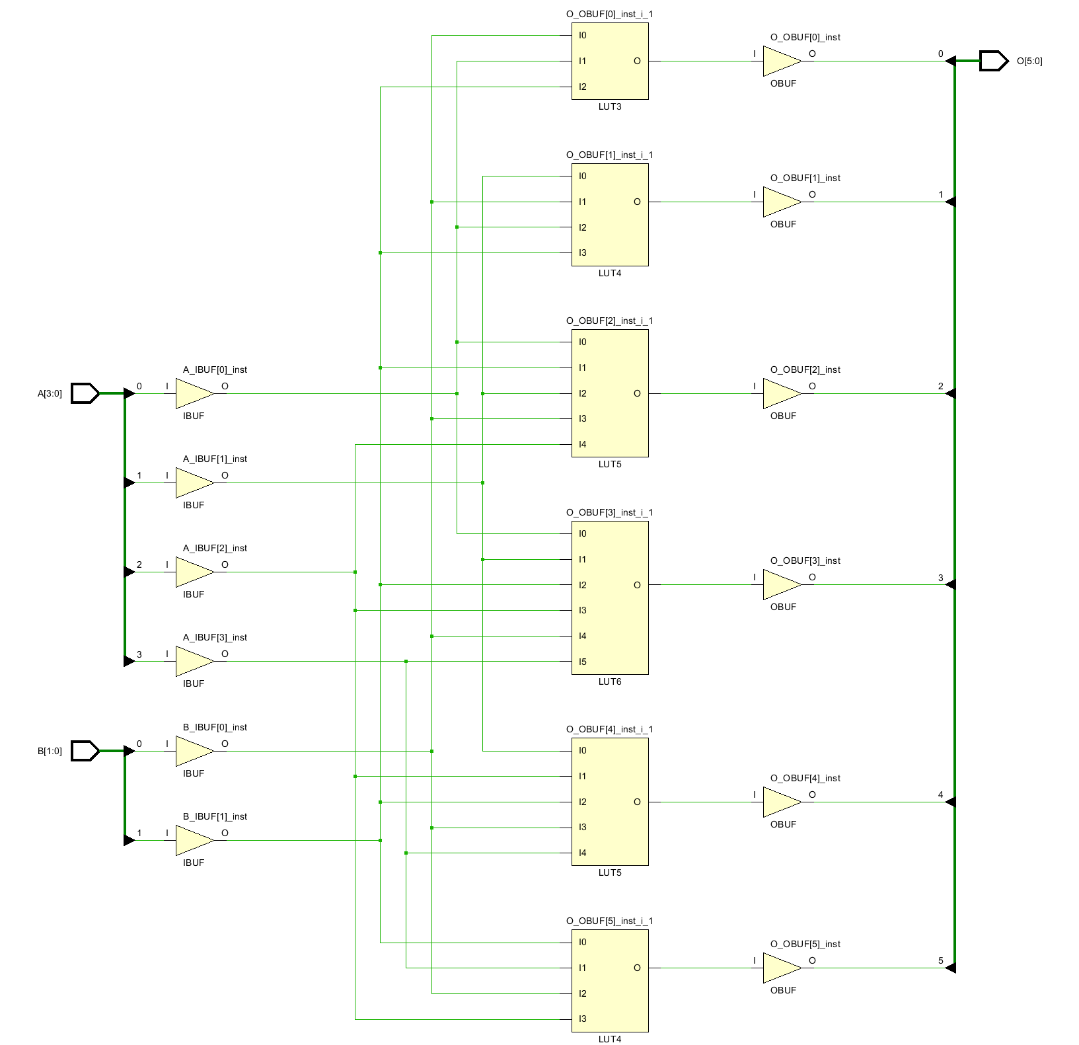
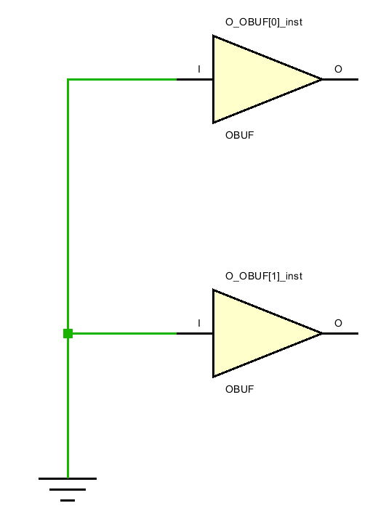
Shift operators
When shift by a constant, simple rewiring is performed.
When performing left shift, the shifted bits are not discarded but imply move into the higher order.
When shift by a variable, a shifter is synthesized.
module demo_17 (A, O);
input [3:0] A;
output [5:0] O;
assign O = A << 2;
endmodule
module demo_18 (A, B, O);
input [3:0] A;
input [1:0] B;
output [5:0] O;
assign O = A << B;
endmodule

Slide 34
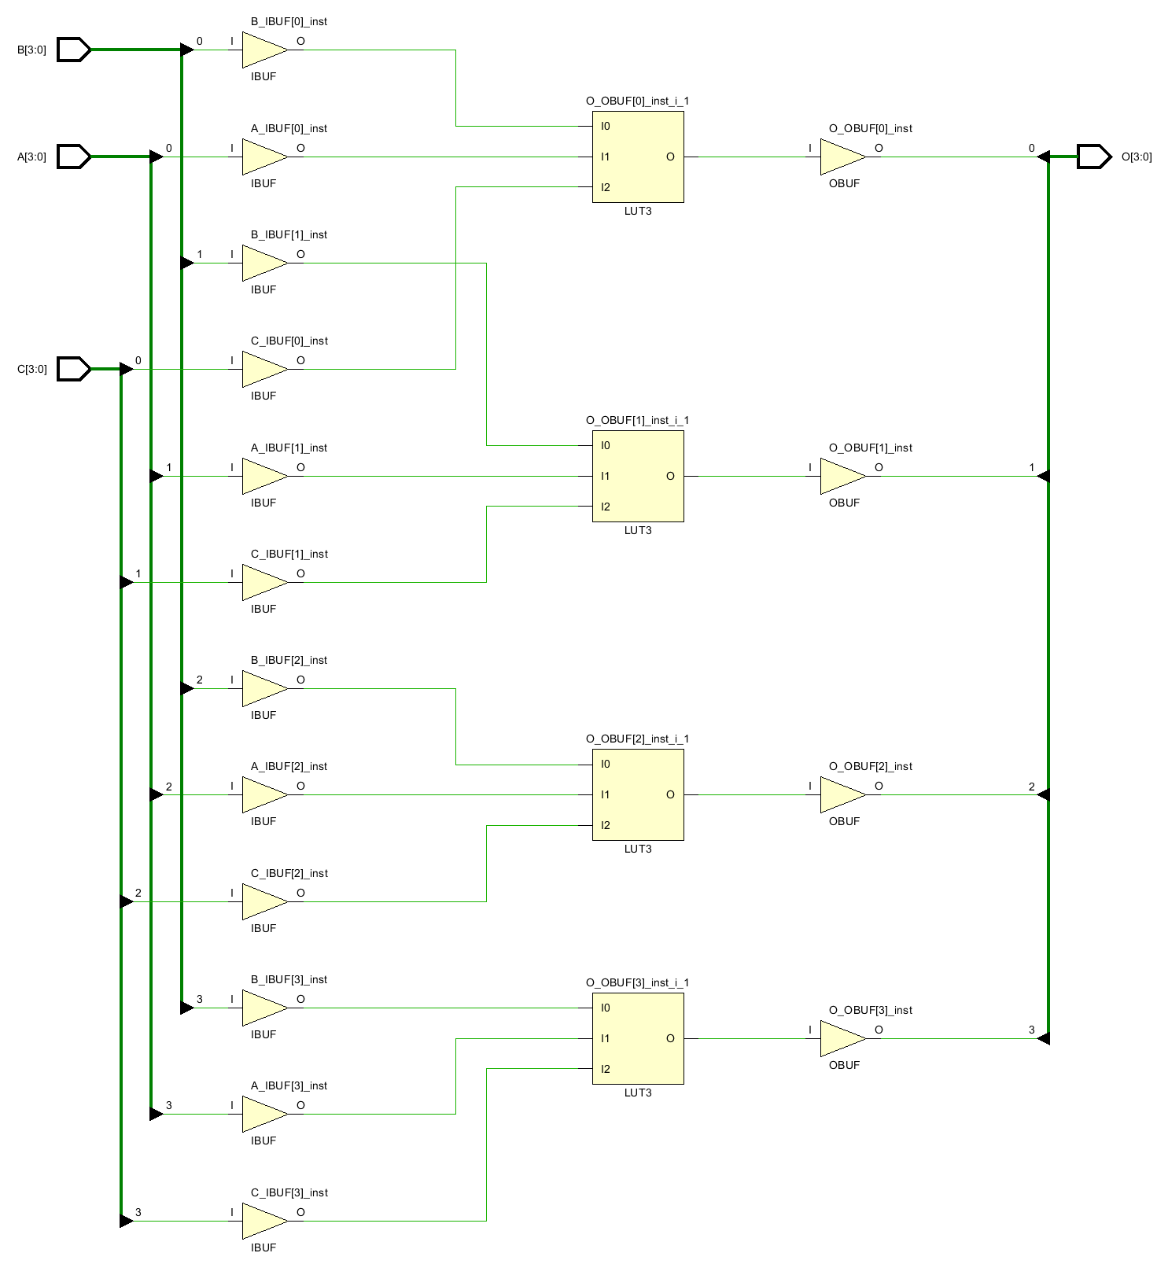
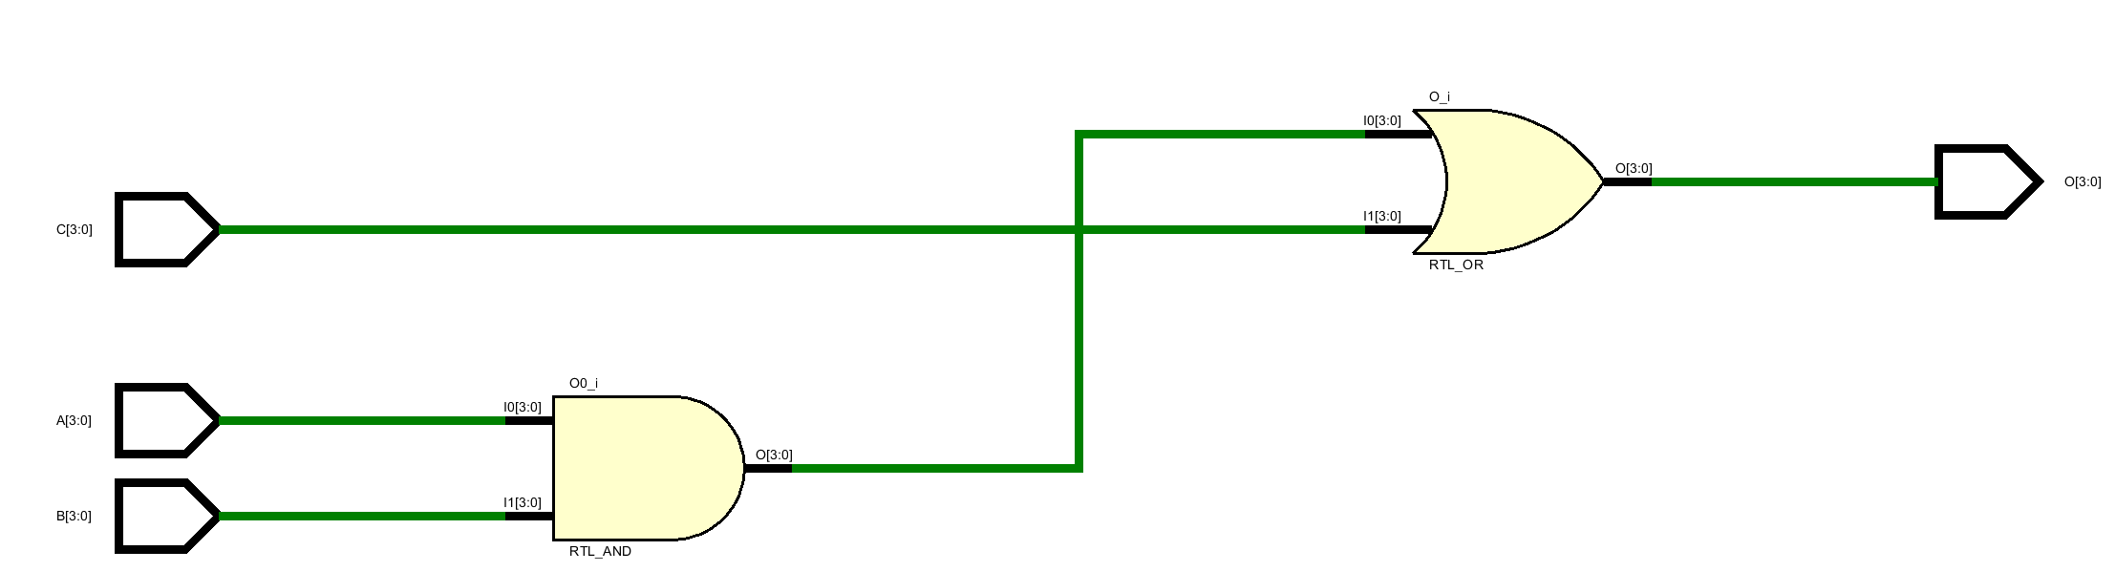
Vector operator
Vector operands can be used in bit-operators. The synthesizer will treat each bit with the same logic.
module demo_19 (A, B, C, O);
input [3:0] A, B, C;
output [3:0] O;
assign O = (A & B) | C;
endmodule

Slide 35
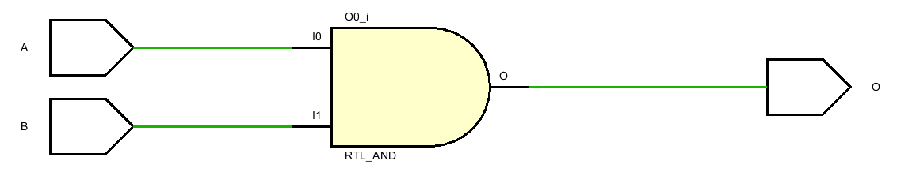
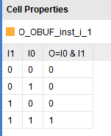
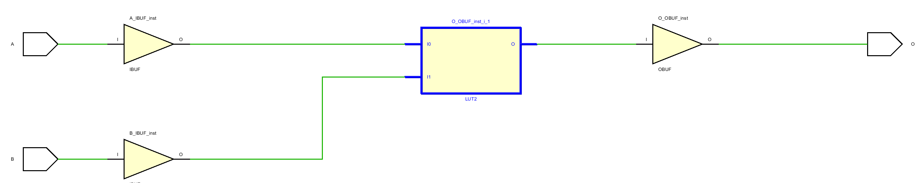
Always statement
An always statement is used to model the procedural behavior of a circuit.
Combinational or sequential
In modeling combinational logic, all variables whose values are read in the always statement should be put in the sensitivity list.
Otherwise, synthesis mismatch happens.
module demo_19 (A, B, O);
input A, B;
output O;
reg O;
always @ (B)
O = A & B;
endmodule

Slide 36

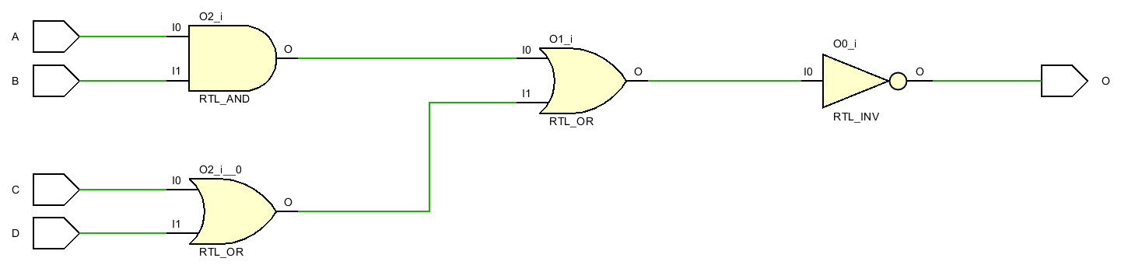


Always statement
A variable declared within an always statements holds a temporary value
module demo_21 (A, B, C, D, O);
input A, B, C, D;
output O;
reg O;
always @ (A, B, C, D) begin: demo_21
reg T1, T2;
T1 = A & B;
T2 = C | D;
T1 = T1 | T2;
O = ~T1;
end
endmodule
module demo_21 (A, B, C, D, O);
input A, B, C, D;
output O;
reg O;
always @ (A, B, C, D) begin: demo_21
reg T1, T2, T3;
T1 = A & B;
T2 = C | D;
T3 = T1 | T2;
O = ~T3;
end
endmodule
Must have a block name for using local variable in always

Slide 37
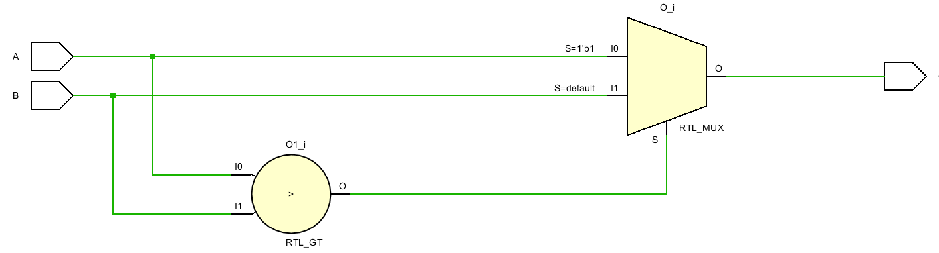
If statement
If statement represents logic that is conditionally controlled.
module demo_22 (A, B, O);
input A, B;
output O;
reg O;
always @ (A, B) begin
if (A > B)
O = A;
else
O = B;
end
endmodule
Beware of signed/unsigned numbers.

Slide 38
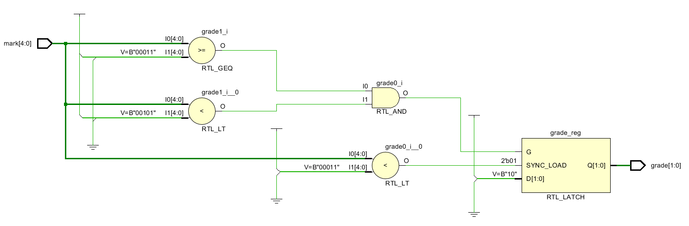
If statement – inferring latches
If a variable is not assigned in all possible executions of an always statement, then a latch is inferred.
When a variable is not assigned in all branches of an if.
module demo_23 (mark, grade);
input [4:0] mark; output [1:0] grade;
reg [1:0] grade;
parameter FAIL = 1, PASS = 2, EXCELLENT = 3;
always @ (mark) begin
if (mark < 3)
grade = FAIL;
else if ((mark >= 3) & (mark < 5))
grade = PASS;
end
endmodule

Slide 39
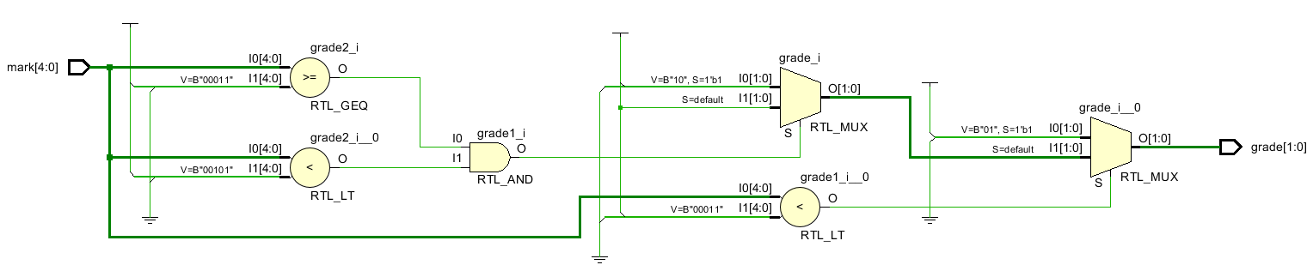
If statement – inferring latches
If a variable is not assigned in all possible executions of an always statement, then a latch is inferred.
When a variable is not assigned in all branches of an if.
Complete up an if-statement with else.
module demo_23 (mark, grade);
input [4:0] mark; output [1:0] grade;
reg [1:0] grade;
parameter FAIL = 1, PASS = 2, EXCELLENT = 3;
always @ (mark) begin
if (mark < 3)
grade = FAIL;
else if ((mark >= 3) & (mark < 5))
grade = PASS;
else
grade = EXCELLENT;
end
endmodule

Slide 40
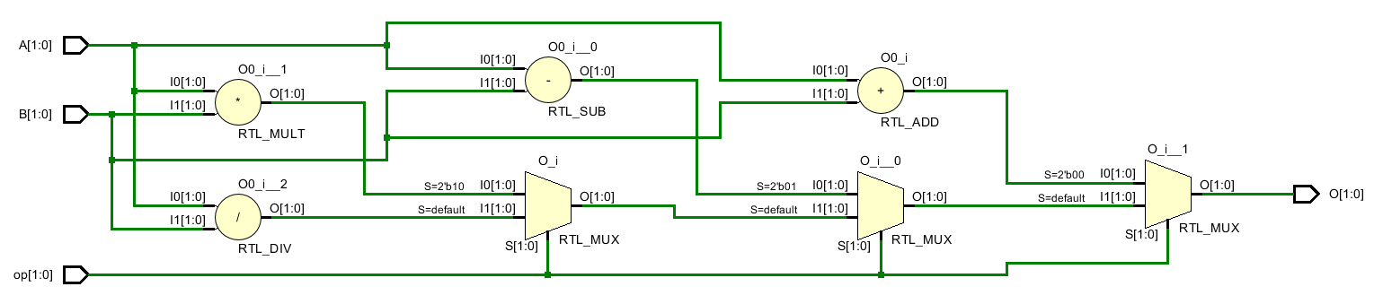
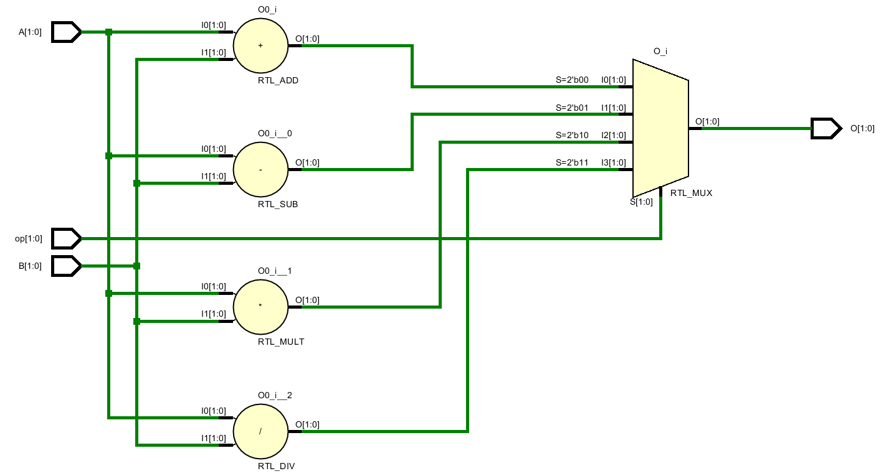
Case statement
If statement
In a case statement, the first branch (thus a priority inferred) that matches is selected. A case item may be a constant or variable.
The order of the case items (branches) matters!
Behave like a nested if but synthesized differently on FPGA!
module demo_24 (op, A, B, O);
input [1:0] op, A, B;
output [1:0] O;
reg [1:0] O;
parameter ADD='b00, SUB='b01, MUL='b10, DIV='b11;
always @ (op, A, B)
case(op)
ADD: O = A + B;
SUB: O = A - B;
MUL: O = A * B;
DIV: O = A / B;
endcase
endmodule
if (op == ADD)
O = A + B;
else if (op == SUB)
O = A – B;
else if (op == MUL)
O = A * B;
else
O = A / B;
Multi-port MUX.
Case statement

Slide 41
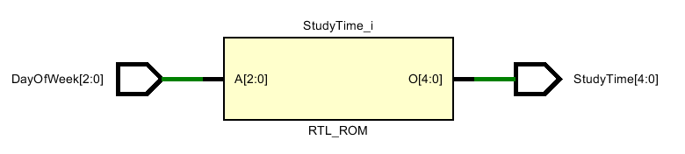
Case statement
module demo_25 (DayOfWeek, StudyTime);
input [2:0] DayOfWeek;
output [4:0] StudyTime;
reg [4:0] StudyTime;
parameter
MON=1, TUE=2, WED=3, THU=4, FRI=5, SAT=6, SUN=7;
always @ (DayOfWeek)
case (DayOfWeek)
MON,
TUE,
WED,
THU: StudyTime = 9;
FRI: StudyTime = 10;
SAT: StudyTime = 20;
SUN: StudyTime = 20;
default:
StudyTime = 5’b11111;
endcase
endmodule
When the MUX does not have enough ports for all options.

Slide 42
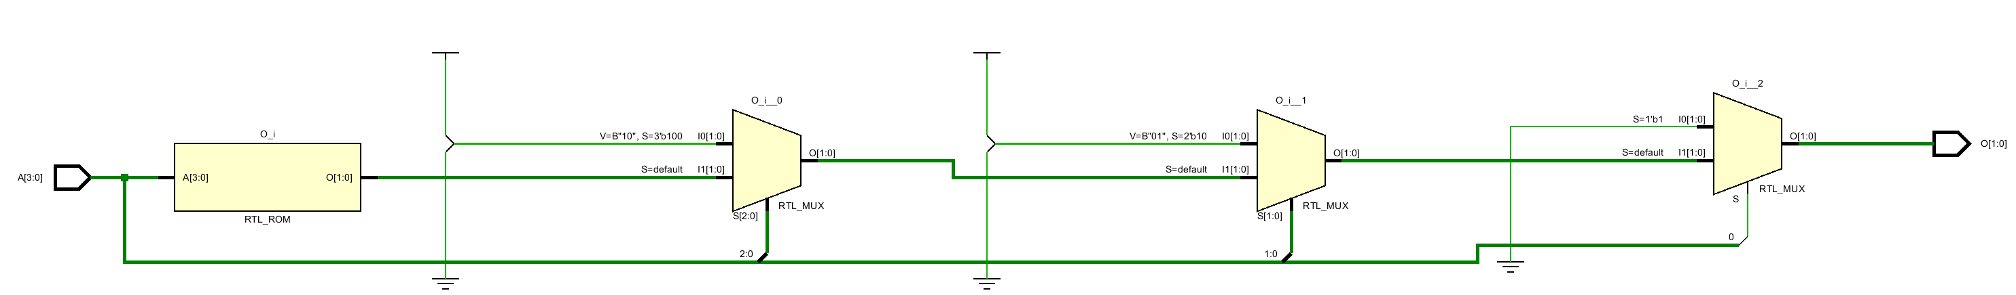
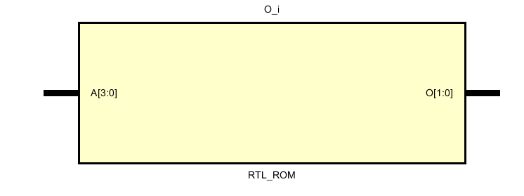
Case statement – casez
In a casez statement, the value z (or ?) is considered as a don’t-care when it appears in a case item expression.
value x cannot appear in a case item expression.
For synthesis, values z and x are not allowed in the case expression.
module demo_26 (A, O);
input [3:0] A;
output [1:0] O;
reg [1:0] O;
always @ (A)
casez(A)
4'bzzz1 : O = 0;
4'bzz10 : O = 1;
4'bz100 : O = 2;
4'b1000 : O = 3;
default : O = 0;
endcase
endmodule
If statement
if (A[0])
O = 0;
else if (A[1:0] == 2’b10)
O = 1;
else if (A[2:0] == 3’b100)
O = 2;
else if (A[3:0] == 4’b1000)
O = 3;
else
O = 0;
Casez statement

Slide 43
Case statement – casez
A[3] | A[2] | A[1] | A[0] | O[1] | O[0]
0 | 0 | 0 | 1 | 0 | 0
0 | 0 | 1 | 1 | 0 | 0
0 | 1 | 0 | 1 | 0 | 0
0 | 1 | 1 | 1 | 0 | 0
1 | 0 | 0 | 1 | 0 | 0
1 | 0 | 1 | 1 | 0 | 0
1 | 1 | 0 | 1 | 0 | 0
1 | 1 | 1 | 0 | 0 | 1
0 | 0 | 1 | 0 | 0 | 1
0 | 1 | 1 | 0 | 0 | 1
1 | 0 | 1 | 0 | 0 | 1
1 | 1 | 0 | 0 | 1 | 0
0 | 1 | 0 | 0 | 1 | 0
1 | 0 | 0 | 0 | 1 | 1
1 | 1 | 1 | 1 | 0 | 0
zzz
module demo_26 (A, O);
input [3:0] A;
output [1:0] O;
reg [1:0] O;
always @ (A)
casez(A)
4'bzzz1 : O = 0;
4'bzz10 : O = 1;
4'bz100 : O = 2;
4'b1000 : O = 3;
default : O = 0;
endcase
endmodule
zz
z

Slide 44
Case statement – casez
A[3] | A[2] | A[1] | A[0] | O[1] | O[0]
0 | 0 | 0 | 1 | 0 | 0
0 | 0 | 1 | 1 | 0 | 0
0 | 1 | 0 | 1 | 0 | 0
0 | 1 | 1 | 1 | 0 | 0
1 | 0 | 0 | 1 | 0 | 0
1 | 0 | 1 | 1 | 0 | 0
1 | 1 | 0 | 1 | 0 | 0
1 | 1 | 1 | 0 | 0 | 1
0 | 0 | 1 | 0 | 0 | 1
0 | 1 | 1 | 0 | 0 | 1
1 | 0 | 1 | 0 | 0 | 1
1 | 1 | 0 | 0 | 1 | 0
0 | 1 | 0 | 0 | 1 | 0
1 | 0 | 0 | 0 | 1 | 1
1 | 1 | 1 | 1 | 0 | 0
module demo_26 (A, O);
input [3:0] A;
output [1:0] O;
reg [1:0] O;
always @ (A)
casez(A)
4'bzzz1 : O = 0;
4'bzz10 : O = 1;
4'bz100 : O = 2;
4'b1000 : O = 3;
default : O = 0;
endcase
endmodule

Slide 45
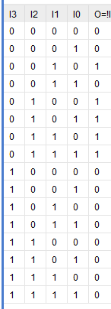
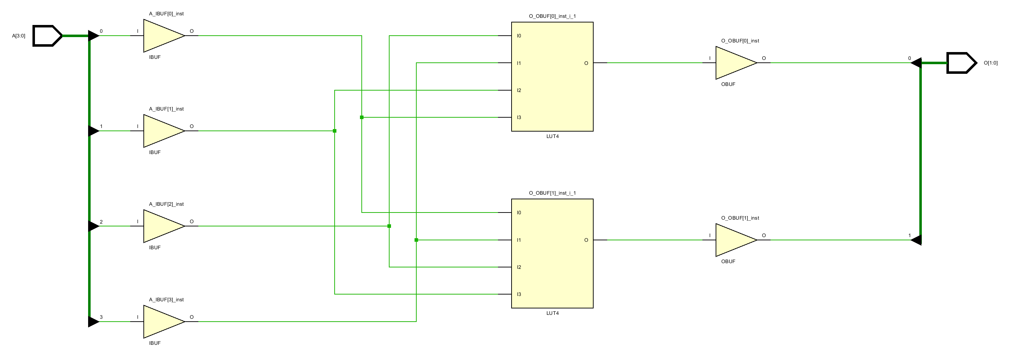
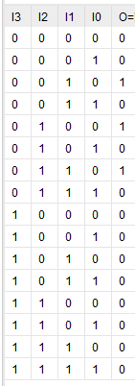
Case statement – casez
A0 A1 A3 A2 O0
A1 A2 A3 A0 O1

Slide 46
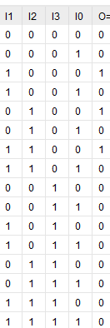
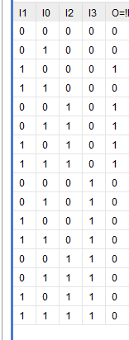
Case statement – casez
A[3] | A[2] | A[1] | A[0] | O[1] | O[0]
0 | 0 | 0 | 1 | 0 | 0
0 | 0 | 1 | 1 | 0 | 0
0 | 1 | 0 | 1 | 0 | 0
0 | 1 | 1 | 1 | 0 | 0
1 | 0 | 0 | 1 | 0 | 0
1 | 0 | 1 | 1 | 0 | 0
1 | 1 | 0 | 1 | 0 | 0
1 | 1 | 1 | 0 | 0 | 1
0 | 0 | 1 | 0 | 0 | 1
0 | 1 | 1 | 0 | 0 | 1
1 | 0 | 1 | 0 | 0 | 1
1 | 1 | 0 | 0 | 1 | 0
0 | 1 | 0 | 0 | 1 | 0
1 | 0 | 0 | 0 | 1 | 1
1 | 1 | 1 | 1 | 0 | 0
A3 A2 A1 A0 O1
A3 A2 A1 A0 O0

Slide 47
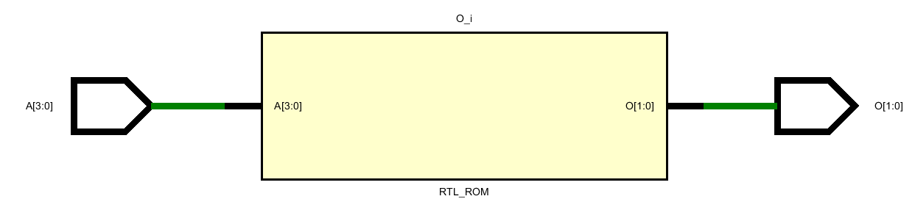
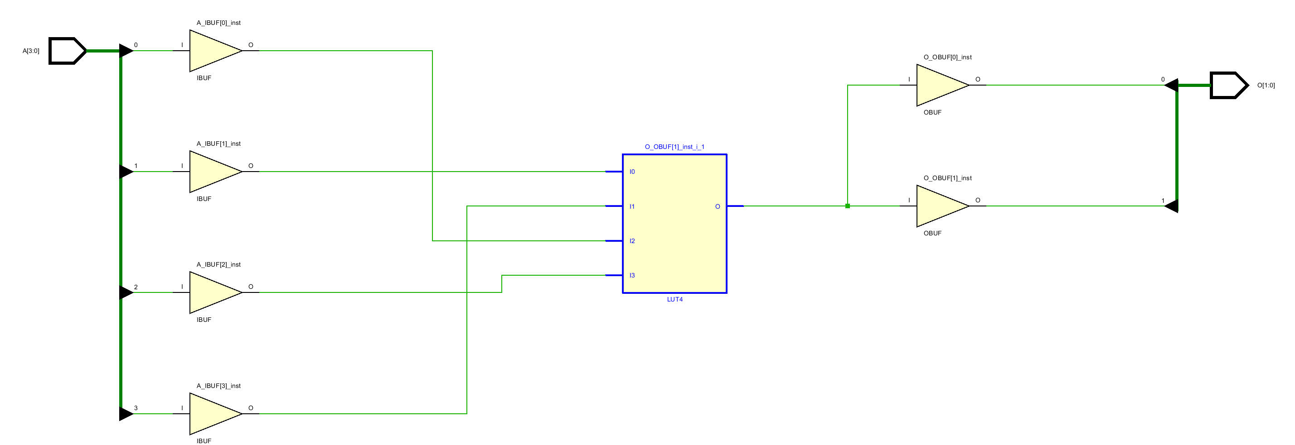
Case statement – casez
module demo_26 (A, O);
input [3:0] A;
output [1:0] O;
reg [1:0] O;
always @ (A)
casez(A)
4’bxxx1 : O = 0;
4’bxx10 : O = 1;
4’bx100 : O = 2;
4'b1000 : O = 3;
default : O = 0;
endcase
endmodule

Slide 48
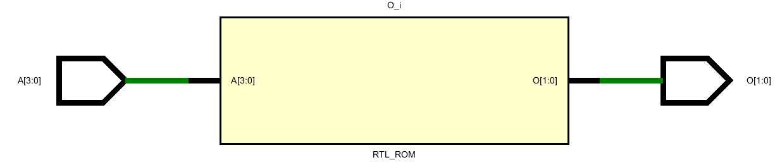
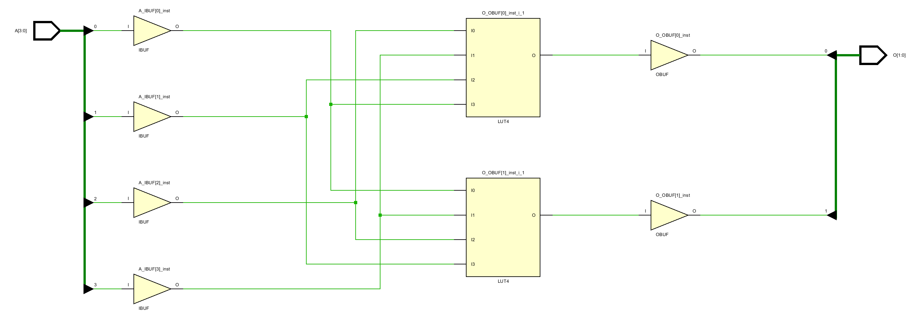
Case statement – casex
In a casex statement, the values x, z (or ?) are considered as a don’t-care when it appears in a case item expression.
value x cannot appear in a case item expression.
For synthesis, values x and z are not allowed in the case expression.
module demo_27 (A, O);
input [3:0] A;
output [1:0] O;
reg [1:0] O;
always @ (A)
casex(A)
4’bxxx1 : O = 0;
4’bxx10 : O = 1;
4’bx100 : O = 2;
4'b1000 : O = 3;
default : O = 0;
endcase
endmodule

Slide 49
Case statement – inferring latches
A latch may be inferred for a variable assigned in a case statement, just as in an if statement.
A variable is assigned a value only in partial branches of a case statement.
To avoid latch
Add an initial value assignment before case
Complete the case statement with default branch
Use full case directive (not recommended)

Slide 50
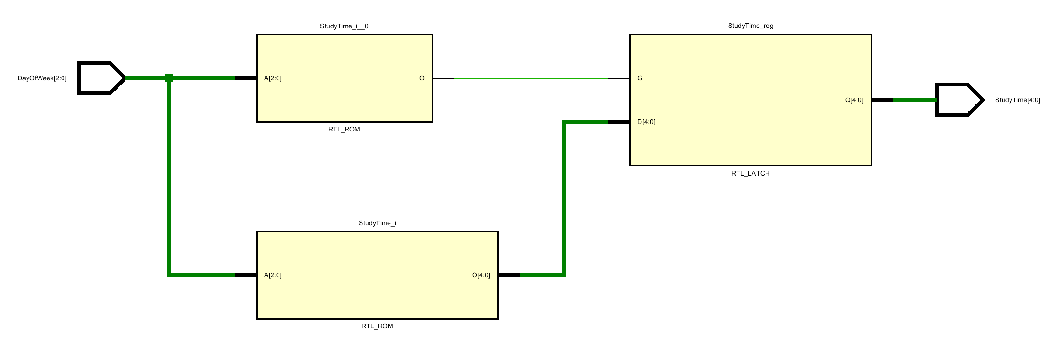
Case statement – inferring latches
module demo_25 (DayOfWeek, StudyTime);
input [2:0] DayOfWeek;
output [4:0] StudyTime;
reg [4:0] StudyTime;
parameter
MON=1, TUE=2, WED=3, THU=4, FRI=5, SAT=6, SUN=7;
always @ (DayOfWeek)
case (DayOfWeek)
MON,
TUE,
WED,
THU: StudyTime = 9;
FRI: StudyTime = 10;
SAT: StudyTime = 20;
SUN: StudyTime = 20;
default:
StudyTime = 5’b11111;
endcase
endmodule

Slide 51
Case statement – inferring latches
module demo_25 (DayOfWeek, StudyTime);
input [2:0] DayOfWeek;
output [4:0] StudyTime;
reg [4:0] StudyTime;
parameter
MON=1, TUE=2, WED=3, THU=4, FRI=5, SAT=6, SUN=7;
always @ (DayOfWeek)
case (DayOfWeek)
MON,
TUE,
WED,
THU: StudyTime = 9;
FRI: StudyTime = 10;
SAT: StudyTime = 20;
SUN: StudyTime = 20;
default:
StudyTime = 5’b11111;
endcase
endmodule
module demo_28 (DayOfWeek, StudyTime);
input [2:0] DayOfWeek;
output [4:0] StudyTime;
reg [4:0] StudyTime;
parameter
MON=1, TUE=2, WED=3, THU=4, FRI=5, SAT=6, SUN=7;
always @ (DayOfWeek) begin
StudyTime = 5’b11111;
case (DayOfWeek)
MON,
TUE,
WED,
THU: StudyTime = 9;
FRI: StudyTime = 10;
SAT: StudyTime = 20;
SUN: StudyTime = 20;
endcase
end
endmodule

Slide 52

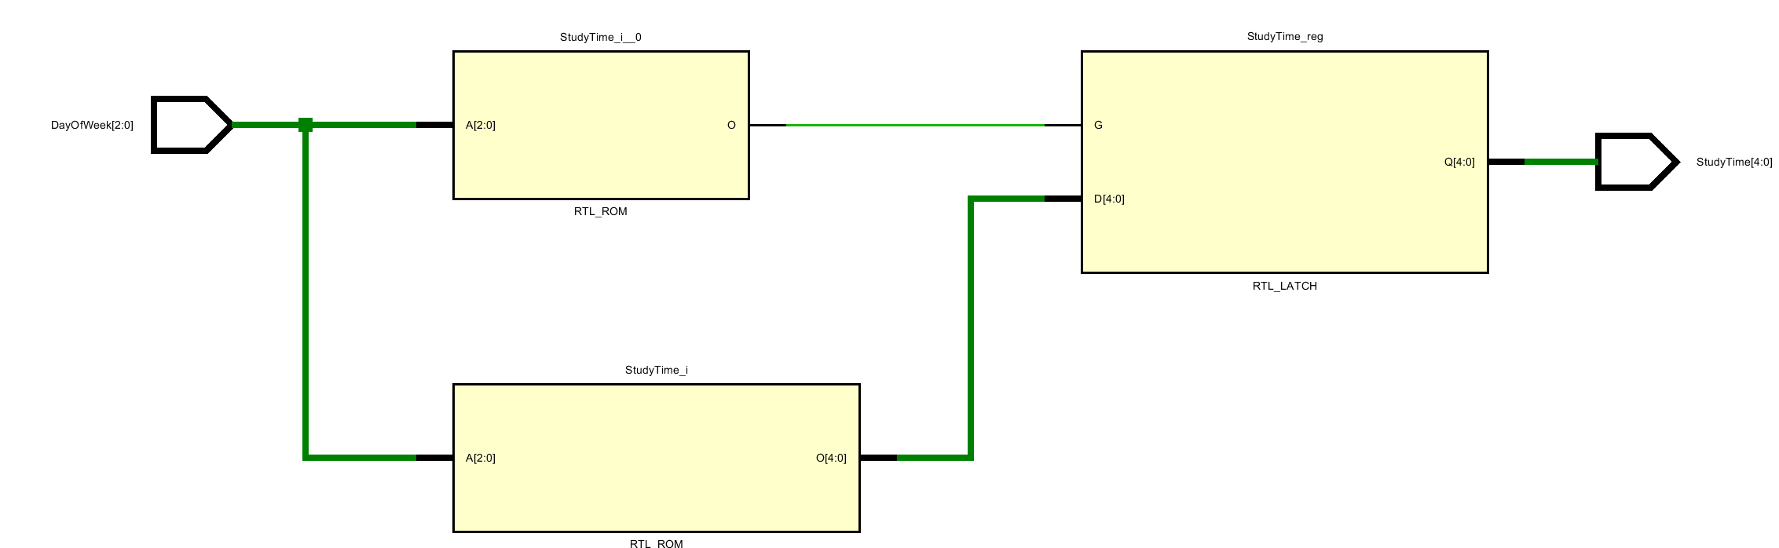
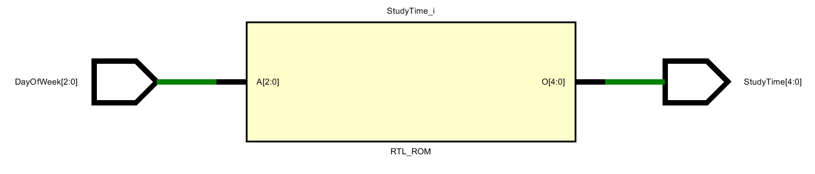
Case statement – full case
Sometimes we are sure that the case expression cannot have value other than those listed in the case items.
module demo_25 (DayOfWeek, StudyTime);
input [2:0] DayOfWeek;
output [4:0] StudyTime;
reg [4:0] StudyTime;
parameter
MON=1, TUE=2, WED=3, THU=4, FRI=5, SAT=6, SUN=7;
always @ (DayOfWeek)
case (DayOfWeek)
MON,
TUE,
WED,
THU: StudyTime = 9;
FRI: StudyTime = 10;
SAT: StudyTime = 20;
SUN: StudyTime = 20;
endcase
endmodule
module demo_29 (DayOfWeek, StudyTime);
input [2:0] DayOfWeek;
output [4:0] StudyTime;
reg [4:0] StudyTime;
parameter
MON=1, TUE=2, WED=3, THU=4, FRI=5, SAT=6, SUN=7;
always @ (DayOfWeek)
case (DayOfWeek) // synthesis full_case
MON,
TUE,
WED,
THU: StudyTime = 9;
FRI: StudyTime = 10;
SAT: StudyTime = 20;
SUN: StudyTime = 20;
endcase
endmodule
Not recommended.
Mismatch can occur between behavioral simulation and synthesis.

Slide 53
Case statement – parallel case
Sometimes we are sure that the case branches are mutual exclusive and do not overlap with each other.
Thus, no need to synthesis priority-based logic to match case branch.
Not recommended.
It may be very difficult to make sure that the switch branches are mutual exclusive.
if (A[0])
O = 0;
if (A[1:0] == 2’b10)
O = 1;
if (A[2:0] == 3’b100)
O = 2;
if (A[3:0] == 4’b1000)
O = 3;
if (!A[0] &&
!(A[1:0] == 2’b10) &&
!(A[2:0] == 3’b100) &&
!(A[3:0] == 4’b1000))
O = 0;
module demo_26 (A, O);
input [3:0] A;
output [1:0] O;
reg [1:0] O;
always @ (A)
casez(A)
4'bzzz1 : O = 0;
4'bzz10 : O = 1;
4'bz100 : O = 2;
4'b1000 : O = 3;
default : O = 0;
endcase
endmodule
module demo_30 (A, O);
input [3:0] A;
output [1:0] O;
reg [1:0] O;
always @ (A)
casez(A) // synthesis parallel_case
4'bzzz1 : O = 0;
4'bzz10 : O = 1;
4'bz100 : O = 2;
4'b1000 : O = 3;
default : O = 0;
endcase
endmodule
if (A[0])
O = 0;
else if (A[1:0] == 2’b10)
O = 1;
else if (A[2:0] == 3’b100)
O = 2;
else if (A[3:0] == 4’b1000)
O = 3;
else
O = 0;

Slide 54
Rules of thumb No.10:
Avoid using the devil twin of full_case and parallel_case.
Re-design the circuit when devils are found.

Slide 55
Loop statement
There are four kinds of loop statements in Verilog
for-loop
while-loop
forever
repeat
The for-loop statement is the one typically supported for synthesis. A for-loop is implemented by unrolling the for-loop, that is, all statements within the for-loop are replicated.
The reason that while loops is un-synthesizable is because it is unclear how many times the loop will exactly run.
Rules of thumb No.11:
Use for-loop in synthesizable code.
Use while, repeat, forever in testbench.

Slide 56
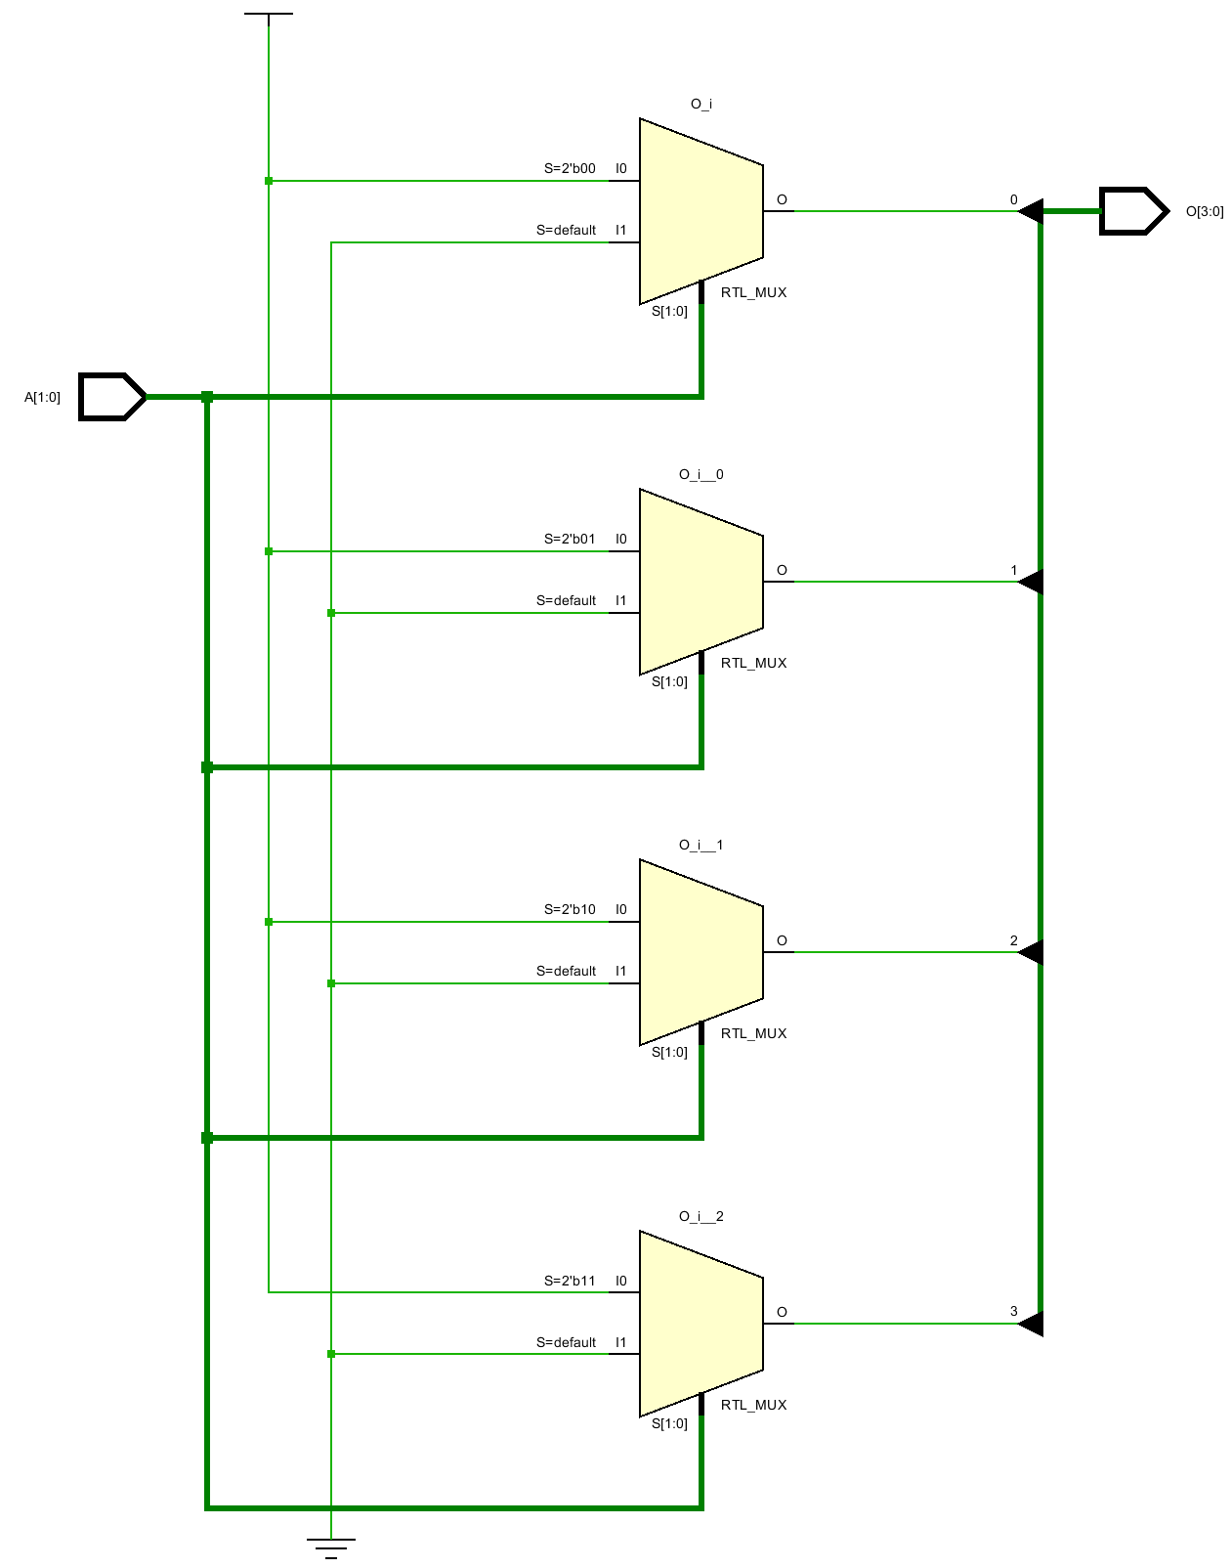
Loop statement
module demo_31 (A, O);
input [1:0] A;
output [3:0] O;
reg [3:0] O;
integer i;
always @ (A)
for (i=0; i<4; i=i+1)
if( A == $unsigned(i) )
O[i] = 1;
else
O[i] = 0;
endmodule
module demo_32 (A, O);
input [1:0] A;
output [3:0] O;
reg [3:0] O;
integer i;
always @ (A) begin
if( A == 0) O[0] = 1;
else O[0] = 0;
if( A == 1) O[1] = 1;
else O[1] = 0;
if( A == 2) O[2] = 1;
else O[2] = 0;
if( A == 3) O[3] = 1;
else O[3] = 0;
end
endmodule
i=i++ is illegal

Slide 57

Questions?

